Slide 1



Code Inspection Document (CID)
Software Engineering 2 Project
Computer Science and Engineering (CSE)
Year 2015/16 - @PoliMi
Background Music:
Hungarian Rhapsody no.2 - F. Liszt
SE2 – Andrea Martino, Francesco Marchesani
POLITECNICO DI MILANO

Slide 2

Purpose
SE2 – Andrea Martino, Francesco Marchesani
This Code Inspection Document (CID) concerns the systematic examination of code about the release of the Glassfish 4.1 Application Server. Here we can see the steps of the SE2 project:
Here we are !!!
RASD
Deadline: 06/11/2015
Final Presentation
TBA
Testing Document
Deadline: 21/01/2016
Code Inspection Document
Deadline: 05/01/2016
Design Document
Deadline: 04/12/2015
Function Points
Deadline: 30/01/2016
POLITECNICO DI MILANO

Slide 3

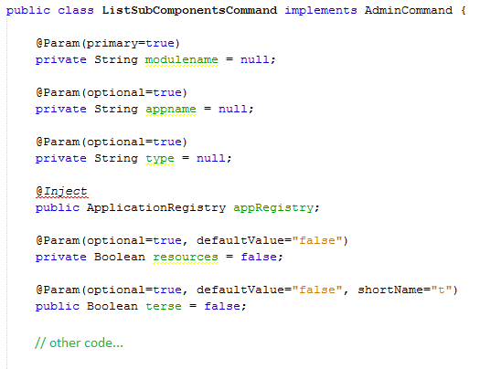
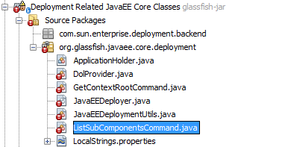
Our Class: listSubComponentsCommand
SE2 – Andrea Martino, Francesco Marchesani
Class name: ListSubComponentsCommand
Full class path:
appserver/deployment/javaee-core/src/main/java/org/glassfish/javaee/core/deployment/ListSubComponents Command.java
Implemented Interface: AdminCommand (org.glassfish.api.admin.AdminCommand)
POLITECNICO DI MILANO

Slide 4
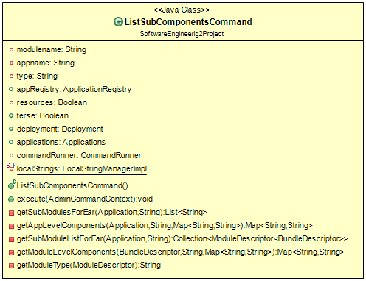
UML Representation
SE2 – Andrea Martino, Francesco Marchesani
POLITECNICO DI MILANO

Slide 5
Functional Role
SE2 – Andrea Martino, Francesco Marchesani
ListSubCompontentsCommand is an implementation of AdminCommand, an interface to provide the command list-sub-components to asadmin utility of GlassFish server.
A brief description of this command is given by GlassFish documentation:
“ The list-sub-commands are subcommand lists EJBs or servlets in a deployed module or in a module of a deployed application. If a module is not specified, all modules are listed. The --appname option functions only when the specified module is standalone.
To display a specific module in an application, you must specify the module name with the --appname option. ”
POLITECNICO DI MILANO

Slide 6
Application deployment
SE2 – Andrea Martino, Francesco Marchesani
Enterprise Java applications are packaged as specialized versions of JAR files before they can be deployed to a Java EE.
EAR: Enterprise application archive.
EJB-JAR: EJB Java archive.
WAR: Web application archives.
POLITECNICO DI MILANO

Slide 7
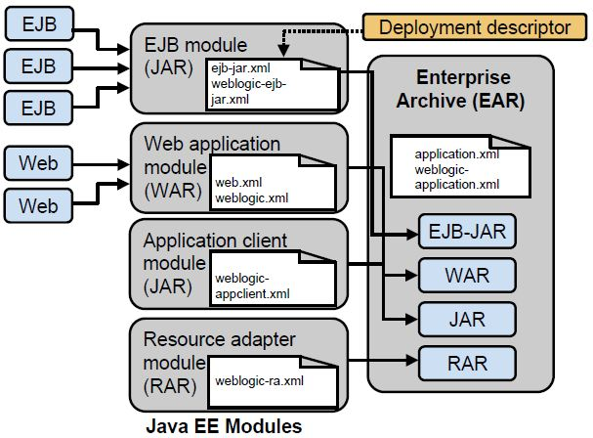
Application deployment
SE2 – Andrea Martino, Francesco Marchesani
POLITECNICO DI MILANO

Slide 8
Some examples…
SE2 – Andrea Martino, Francesco Marchesani
public void execute(AdminCommandContext context)
Line 202 (202:17, 202:189)
a.methodX(b.methodY(“Let’s be very very precise… You don’t look convinced… Is it clear?”, “Never gonna give you up, never gonna let you down…”, c));
Line length: 187
a.methodX(b.methodY(STRING_A, STRING_B, c));
Line length: 107
This method is used to load localized strings from LocalStrings.properties …
POLITECNICO DI MILANO

Slide 9
Some examples…
SE2 – Andrea Martino, Francesco Marchesani
Lines 208 -> 267
{
VarA a = new VarA();
if (b.isClear())
a = h.getA();
if (b.isClear() && c.looksConvinced())
a.doSomething()}
}
a is initialized only to avoid errors at build time.
POLITECNICO DI MILANO

Slide 10
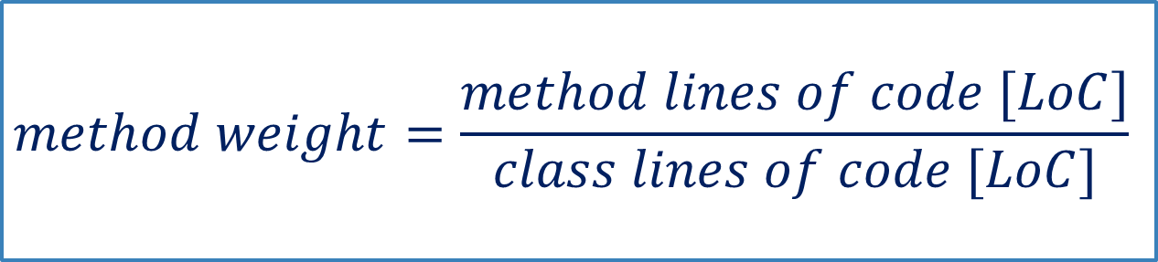
Some statistic of the class…
SE2 – Andrea Martino, Francesco Marchesani
Lines of Code [LoC]: 409 lines
execute() method length: 139 lines
getSubModulesForEar() method length: 14 lines
execute() weight in percentage: ≈ 33,99 %
getSubModulesForEar() weight in percentage: ≈ 3,42 %
Note: the first method is about ten times bigger than the second one!
$$method weight=\frac{method lines of code [LoC]}{class lines of code [LoC]}$$
POLITECNICO DI MILANO

Slide 11
Checklist Issues – Histogram
SE2 – Andrea Martino, Francesco Marchesani
POLITECNICO DI MILANO

Slide 12
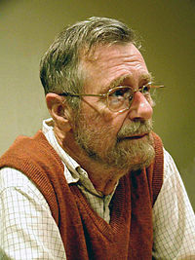
In general…
SE2 – Andrea Martino, Francesco Marchesani
The code has good quality.
There are a lot of checklist points without problems.
But… we need also a Testing Phase after the Code Inspection in order to check the class in practice…
Also remember that (little excursus):
“Testing shows the presence,
not the absence of bugs “ E. Dijkstra
POLITECNICO DI MILANO

Slide 13
Little problems…
SE2 – Andrea Martino, Francesco Marchesani
Few comments!
JavaDoc is poor!
execute() is too long!
… and so on?
POLITECNICO DI MILANO

Slide 14
Suggestions…
SE2 – Andrea Martino, Francesco Marchesani
Improve the Code Documentation with more comments.
Improve the Code Documentation with better JavaDoc (pre/post conditions and so on, as seen in Software Engineering 1).
Use the “Divide et Impera” principle with execute().
… other? /* Sometimes it depends just from your tastes… this is the life! ☺ */
POLITECNICO DI MILANO

Slide 15

Thank you!!!
SE2 – Andrea Martino, Francesco Marchesani
POLITECNICO DI MILANO

